Slide 1
BridgePrep of Tampa – Orientation
Committed to Excellence
SACS Accredited High Performing Charter School - "Where Learning Is A Journey"
Notes:
Harris

Slide 2
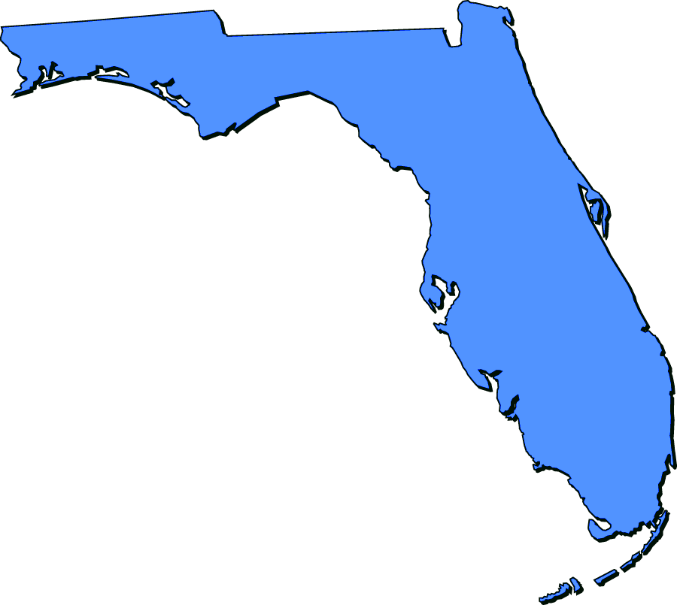
Bridge Prep Academy:
18 Campuses
9 Counties
Duval County:
BridgePrep Academy of Duval (est. 2017)
Polk County:
Bridgeprep Academy of Polk (est. 2022)
Orange County:
BridgePrep Academy of Orange (est. 2016)
Hillsborough County:
BridgePrep Academy of Riverview (est. 2017)
BridgePrep Academy of Tampa (est. 2014)
Osceola County:
BridgePrep Academy of Osceola (est. 2018)
BridgePrep Academy of St. Cloud (to open August 2020)
Palm Beach County:
BridgePrep Academy of Palm Beach (est. 2017)
Collier County:
BridgePrep Academy of Collier (est. 2018)
Broward County:
BridgePrep Academy of Broward (est. 2017)
BridgePrep Academy of Broward K-8
(to open August 2020)
BridgePrep Academy of Hollywood Hills (est. 2014)
Miami-Dade County:
BridgePrep Academy of Greater Miami (est. 2011)
BridgePrep Academy of InterAmerican (est. 2011)
BridgePrep Academy of North Miami Beach (est. 2017)
BridgePrep Academy South Campus (est. 2010)
BridgePrep Academy of Village Green (est. 2011)

Slide 3
Our Instructional Team
Grade Level Introductions:
Primary/ES Intermediate/ ES Intermediate/MS
Kinder Fourth Math
First Fifth Language Arts
Second Social Studies
Third Science
Electives:
Physical Education Music Art
Spanish
Instructional Supports:
Principal
Assistant Principal
Curriculum Coach,
MTSS Coach,
Intensive Lab Teacher
Notes:
HARRIS
With teachers!

Slide 4
Charter Schools
Charter schools are non-profit self-managed entities that enroll students residing in Hillsborough County who would qualify to attend a regular public or private school.
Charter schools must be approved and monitor by the local school district; however; they are operated independently.
In a charter school, the students are district students, meaning that our students are Hillborough County Public School students. Charter schools are funded by state, local and federal monies.
Notes:
HARRIS

Slide 5
Title I Makes a Difference…
Need to know:
Sign in sheet is stating this is our first Annual Meeting & Explanation Session
SDHC writes the grant
School Parent and Families allocate funds cooperatively
Why is TITLE I Important to us?
Parent Participation help set parameters
Input via Survey Link will assist in spending
Survey Links are critical for participation
Allocation:
Equipment, objects, materials and personnel

Slide 6
Our Mission Statement
BridgePrep Academy believes every child learns best in a safe, nurturing and stimulating environment where high academic expectations, self-esteem, good character and an appreciation for the arts are promoted.
BridgePrep Academy’s mission is to provide a challenging academic curriculum that will encompass an extended Spanish language program, technology and experiences that will enable students to develop in all areas.
BridgePrep Academy’s goal is to educate well rounded individuals and enable students to reach their maximum potential.
Notes:
Introductions

Slide 7
Keys to Our Success
Rigorous Academic Curriculum
Extended Secondary Spanish Language Model
Safe & Nurturing Learning Environment
Parental Involvement and Participation
Maintaining School’s Financial Viability
Various locations throughout Florida

Slide 8
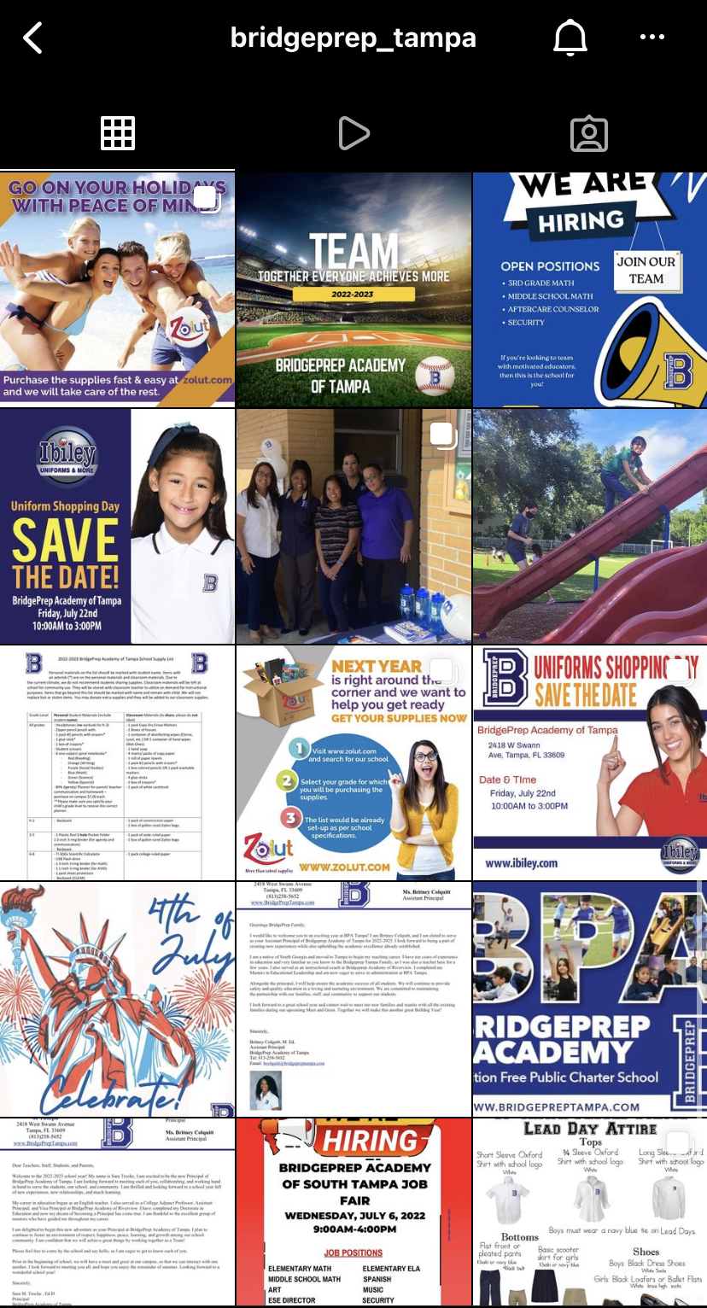
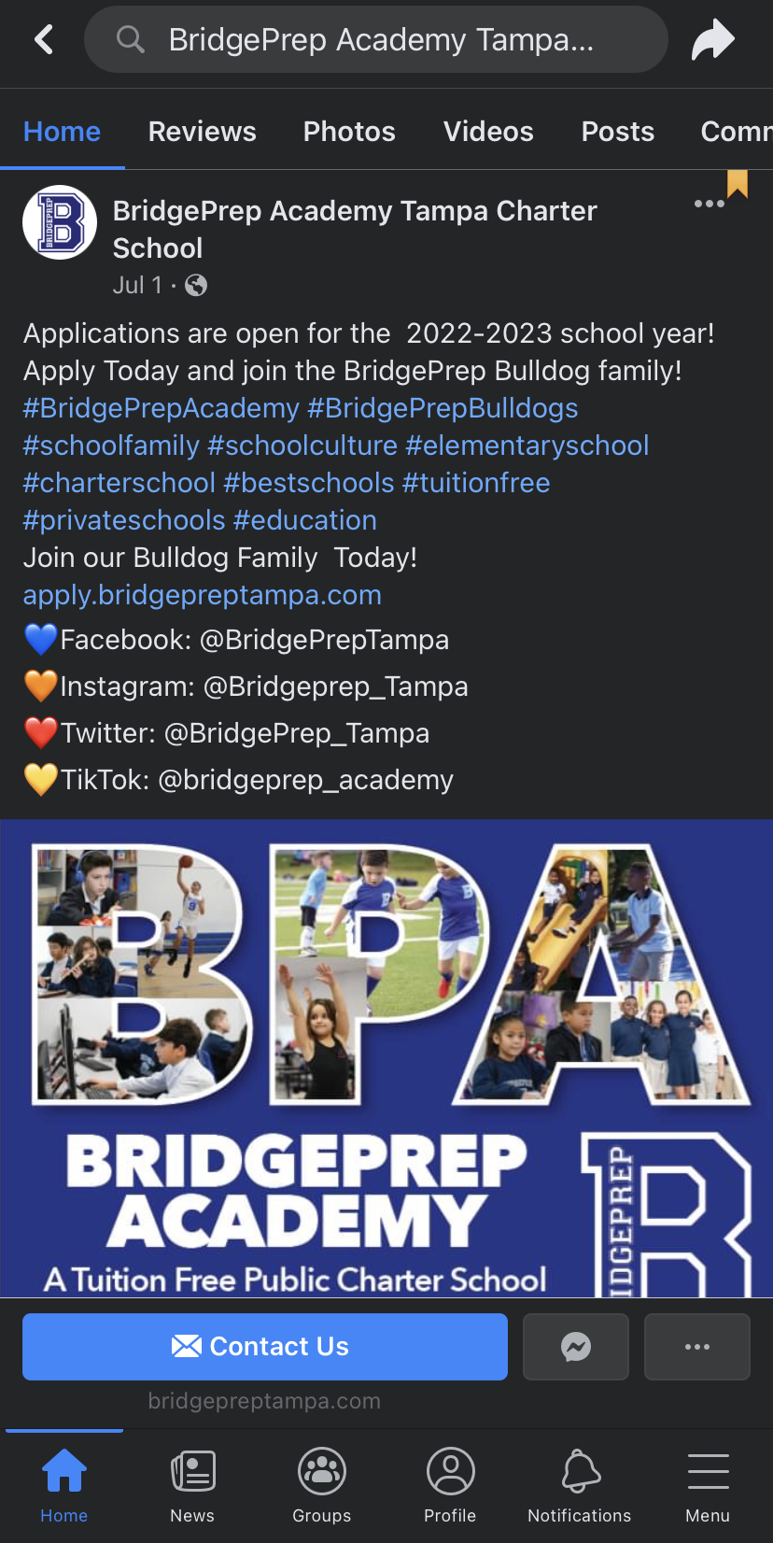
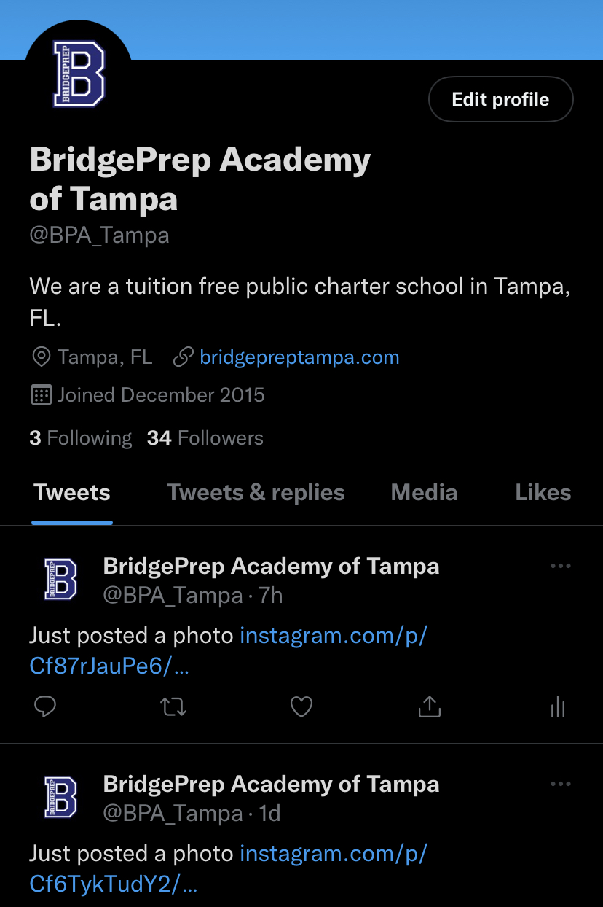
Communication is KEY:
Red Comm. Folder/Planners +
Building Marquee +
Parent Link +
Quarterly Conference PM+
Notes:
HARRIS

Slide 9
GO Green!
Being green, environmentally friendly, promoting recycling, and teaching the students the importance of conserving the environment is another priority.
Including Communication
Phone App, Website, Facebook, Class DoJo, Edsby, Markee’s, Building Postings, Flyers
Notes:
HARRIS

Slide 10
Parent Active in Volunteering for Education
PARENT TEACHER COMMITTEE & STUDENT ADVISORY
Required 20 volunteer hours (prior to last day of school)
SDHC paperwork required talk to front office
SDHC Volunteer Clearance are needed to interact with any student on campus during school events and hours
Please keep a log of your hours via the front office book
Ways to Volunteer on page 27 on the Parent/Student Handbook
Notes:
Mizzi

Slide 11
SDHC Volunteer Required Form Clearance
Notes:
MIZZI

Slide 12
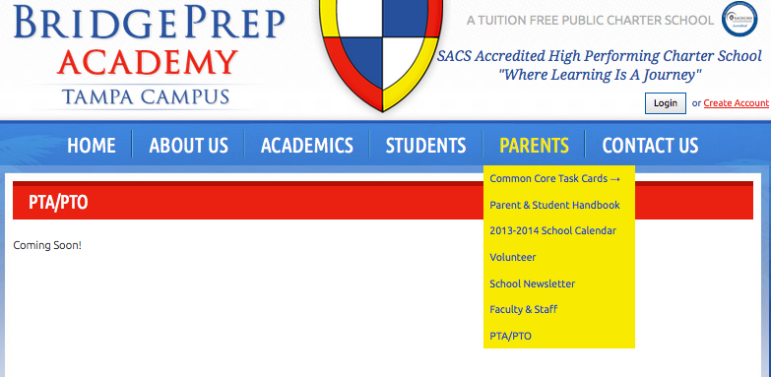
PTC - Parent Teacher Committee
JOIN to be a part of our TEAM
Assistant Principal = Ms. Colquitt Serving PTC
bcolquitt@bridgepreptampa.com
Notes:
MIZZI

Slide 13
PTC - Parent Teacher Committee
Fundraising
Several fundraising opportunities will be available throughout the school year.
These funds are essential to maintain continuous improvements in our school.
We are confident that our BridgePrep families will enjoy participating and supporting the school in these events.
Volunteer hours are accumulated for parent participation and donations for these events.
Notes:
Mizzi

Slide 14
School Spirit / Support
Support our school Event(s):
Occurs monthly (minimum)
Some one campus others off campus
Participation / Attendance Highly Encouraged
Notes:
Mizzi

Slide 15
ClassDojo
Positive Behavior Support System
EXPECT:
Daily communication (Class DoJo)
As needed Mentor Form
BridgePrep students are encouraged to be Scholars:
DELIVER:
Redirection Celebration
Proximity > Warning Weekly Recog.
Move Seat Monthly Cert.
Move Class Yearly Awards
Notes:
Mizzi
With family commitment and participation we have healthier and happier students
We stay connected.
Here is how our connections will look for behavior indicators….
Leads them to the handbook online to sig page

Slide 16
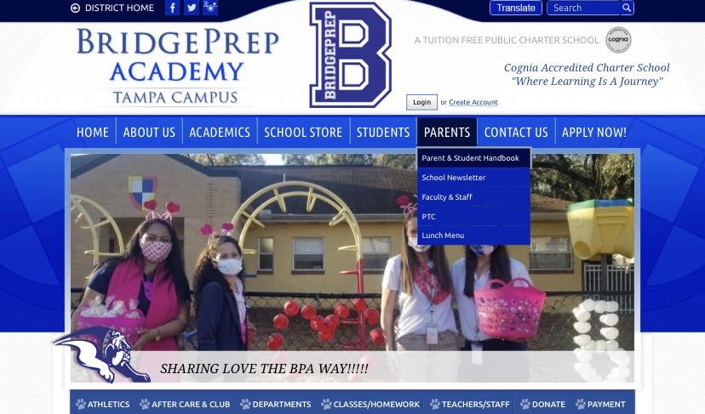
Parent Student Handbook
http://batampa.bridgeprepacademy.com/
Notes:
MIZZI

Slide 17
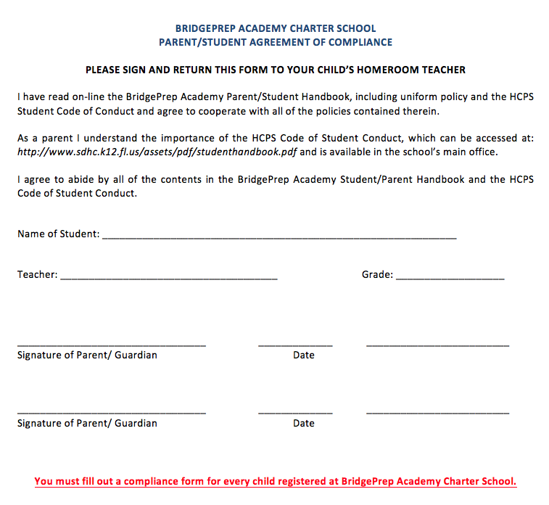
Handbook : Agreement Compliance Form
Notes:
Mizzi – Please submit the last page of the handbook to your homeroom teacher to file.

Slide 18
Technology
Our schools are committed to providing
technology-rich environments for our students.
Classroom Computers
Computer Labs
Mobile Laptop Carts
iPads
Online Software
Smart Technology Projectors
Microsoft for Education
Notes:
Introductions

Slide 19
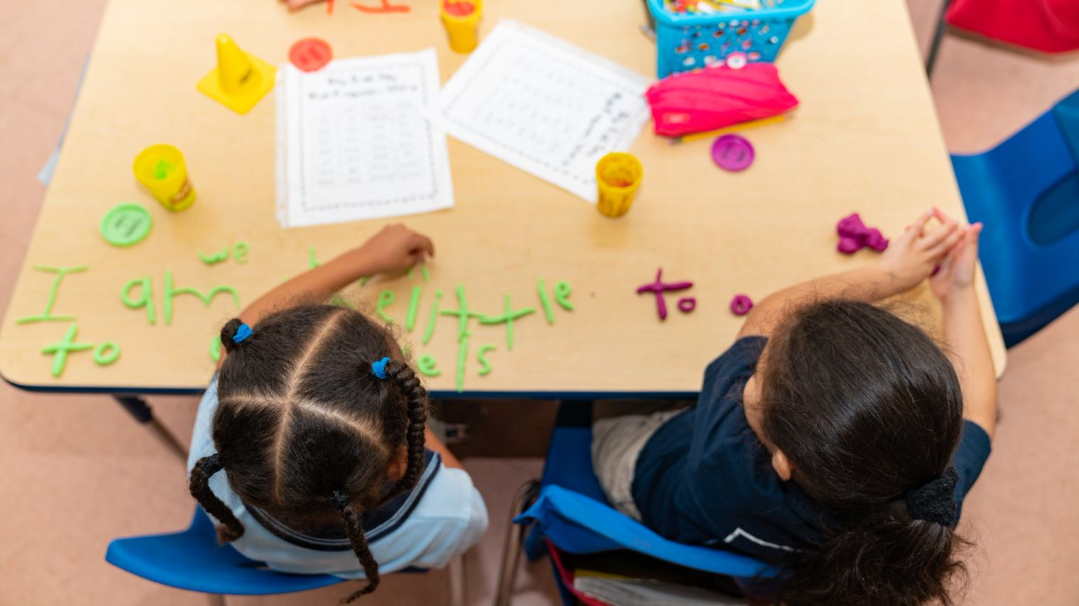
Curriculum
BridgePrep Academy integrates Hillsborough County competency based core curriculum with the Florida State Standards.
BridgePrep Academy curriculum includes greater rigor in coursework and increased student performance expectations.
BridgePrep Academy is designed to meet the needs of each student through differentiated instruction & customization for each child.
BridgePrep is a dual language curriculum in which students will be taught how to read, write, think, and speak in English & Spanish K-8
Notes:
Introductions

Slide 20
Dual Language Spanish program:
One hour per day of Spanish language and literature instruction for speakers and non-speakers of the language.
The goal of the dual language program is to educate students to develop proper reading, writing and language skills in Spanish and English.
*30-60 minutes of extended instruction daily
Notes:
Introductions

Slide 21
BPA HOURS OF OPERATION
Grade Level | Day of the Week | Times
Grade Kinder & 1st | Monday | 8:00 AM – 1:45 PM
Grade Kinder & 1st | Tuesday through Friday | 8:00 AM – 2:45 PM
Grades Second through Eighth | Monday | 8:00 AM - 2:30 PM
Grades Second through Eighth | Tuesday through Friday | 8:00 AM – 3:30 PM
FACULTY & STAFF HOURS
BPA Staff & Faculty | Monday through Friday | 7:45 AM – 3:45PM
Aftercare will be provided to students who have siblings in grades 2-8 for the extra 45 min. only @ no cost
Notes:
HARRIS

Slide 22
Important Arrival Details
School starts promptly at 8:00 a.m. (BOTH Buildings)
SCHOOLHOUSE will open doors at 7:55AM CLOSES @ 8:05AM
Children purchasing breakfast will be admitted into the Cafeteria at 7:30 a.m. (Even within the PLC)
Bell Work 7:45 – 7:55 am
Morning ANNOUNCEMENTS (zoom into classes) 7:55 am
Instruction begins promptly at 8:00 a.m.
If child arrives after @ 8:00AM, they are tardy & a pass is needed (Parking!)
With the new Safety Schools Act an SSO will be on campus during school hours and access to building will be monitored and closed on time for the safety of our children

Slide 23
SDHC Student Nutrition Services Foods
Every Child/Family
Will receive:
5 service hours if completed by Aug 15th
3 service hours if completed by Aug. 17th
Notes:
Harris

Slide 24
Lunch Payment Options
A student may bring their lunch to school or purchase lunch from our cafeteria @ approx. $4.00 per lunch.
ONLINE PAYMENTS, available and in first day packets.
If your child qualifies for free or reduced lunch arrangements will be made accordingly
(APPLY ONLINE).
No money will be exchanged in the cafeteria (PAY online or in check/money order for the week)
Money Order or Check must be in an envelope with: Your child's name, homeroom teacher, grade level, and amount.
Parents of siblings @ BPA, please place money for each individual child in his or her own envelope.
Teachers eat with students during their lunch time.
**ALL PARENTS MUST COMPLETE THE FREE REDUCED – PRICE SCHOOL MEALS APP IN 1ST DAY PACKET**
Notes:
HARRIS

Slide 25
Dress Code
Uniforms
BridgePrep students are REQUIRED to wear uniforms via
iBiley.
Tops: Polos that are White, Light Blue or Navy Blue,
Gray (HS ONLY) with the approved school logo
Bottoms: Pants, knee length skirts or shorts that are Navy Blue or Khaki
Middle School: CLEAR BOOKBAGS
BridgePrep students are REQUIRED to wear closed-toed & closed back shoes.
NO crocs, sandals, slides, flip flops or house shoes
For the convenience of BridgePrep families, the school will host private Ibiley Uniform sale events at the school a few times a year.

Slide 26
Lead Day for Middle School: Grades 6 – 8
Every Wednesday 6th 7th and 8th graders wear professional attire as Leaders for BPA Tampa.
They are role models for our school and future LEADERS in our global economy.
Lead Day speakers will be encouraged to visit campus to speak with middle school students on Wednesdays. One speaker monthly is the goal. If interested please email Ms. Colquitt: bcolquitt@bridgeptampa.com

Slide 27
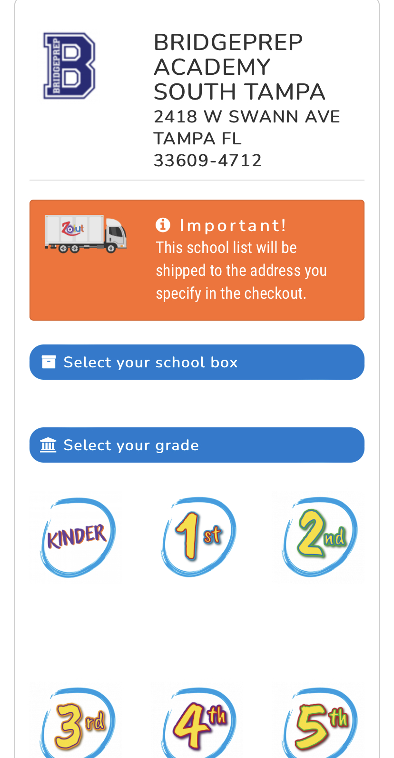
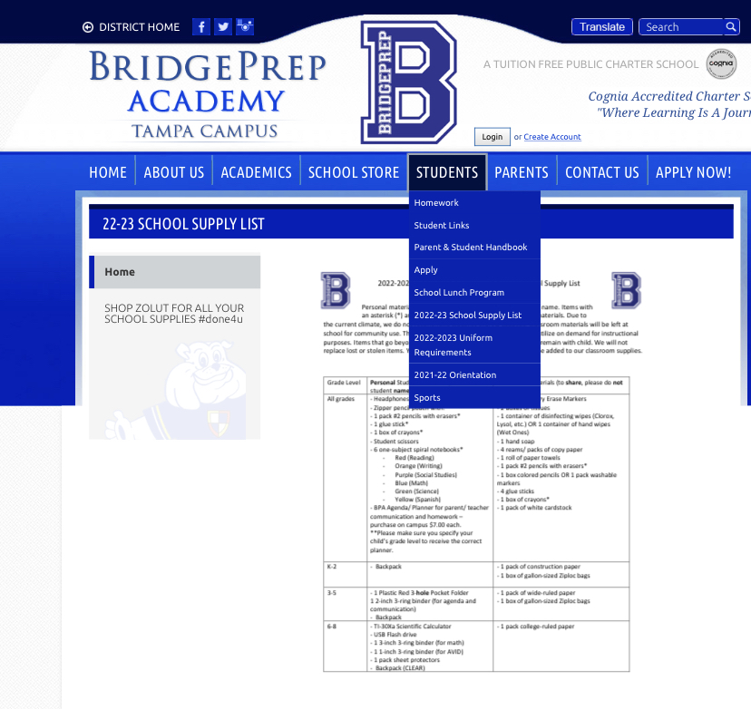
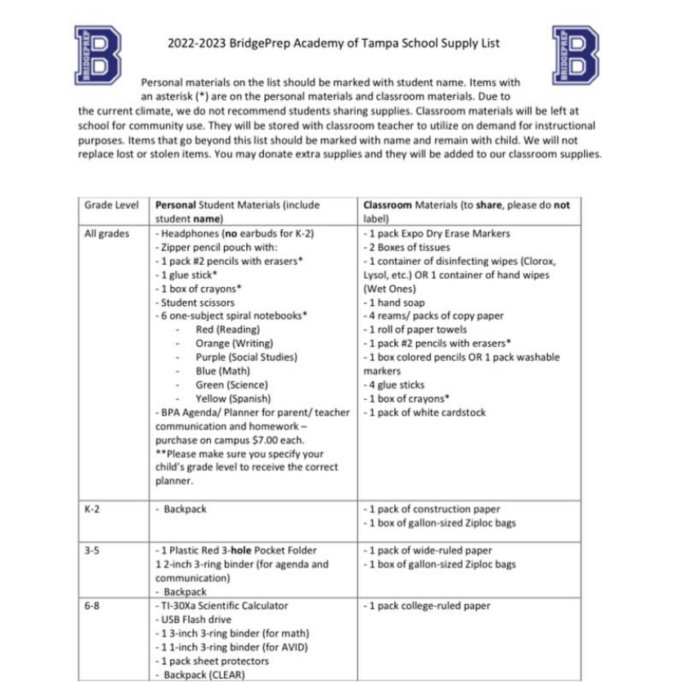
Supplies
Middle School
Clear Backpacks

Slide 28
Arrival & Dismissal: Main Schoolhouse
BPA TAMPA-ARRIVAL & DISMISSAL
SWANN AVE.
SWANN AVE.
SWANN AVE.
WALKERS ONLY
Church Office
GYM
ENTER & STOP @ STAFF FOR CHILD’S NAME
ADMIN OFFICE
SOUTH MOODY AVE.
LEAVE/MOVE OUT ON INNER LANE
5
1
2
3
4
GO TO ASSIGNED CONE NUMBER AND WAIT FOR CHILD(REN)
PLAYGROUND
MAIN SCHOOL BUILDING
PLC

Slide 29
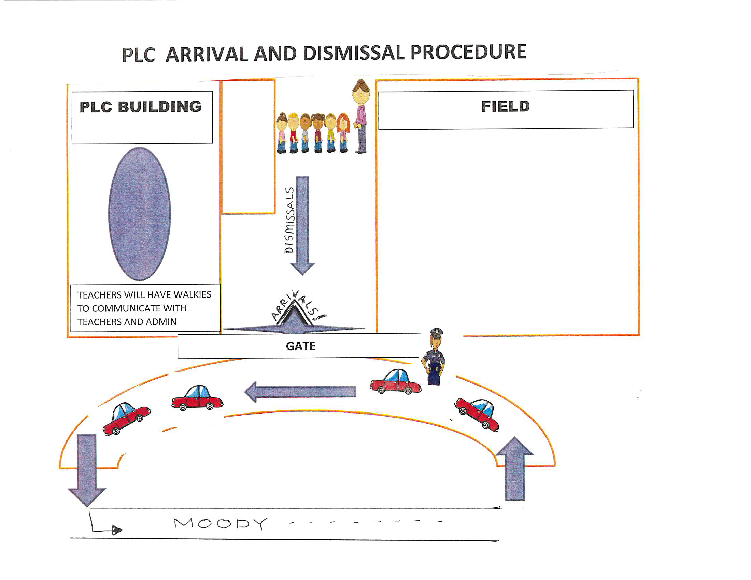
Arrival & Dismissal: PLC (Primary Learning Center)

Slide 30
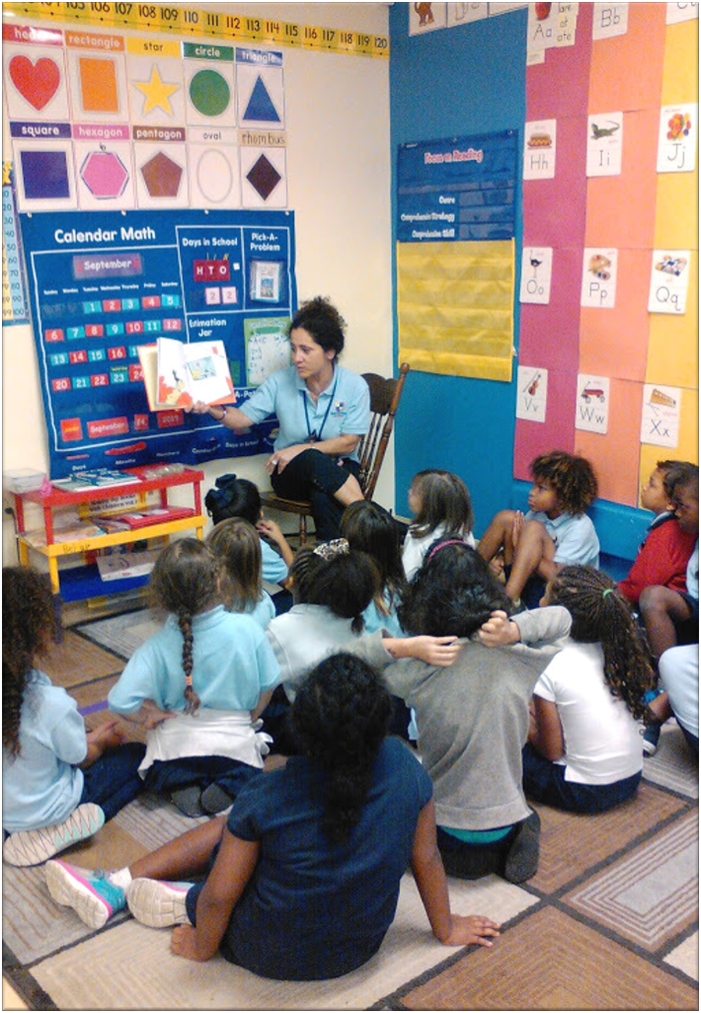
BridgePrep Academy of Tampa Before and Aftercare Payments
Initial Sign-Up Cost
Fees and Services
20 Registration Fee per Child
Minimum Deposit of $100.00 Is Required upon Registration.
Your account must always have a minimum of $100.00.
NO CASH ACCEPTED.
Payments made to the Director ONLY.
Charged daily:
Before Care
$5.00
Aftercare
$10.00
Both
$15.00

Slide 31
Homework
HOMEWORK DAILY THROUGH TECHNOLOGY & FOLLOWING THE SUGGESTED TIMEFRAME

Slide 32
STAY CONNECTED
Early Dismissal on Monday’s Gr. K-8
Events
Updated Calendars
School Important Updates
Grades
Conference Week
Awards / Recognitions / Behaviors
And MUCH MORE…

Slide 33
Before you Leave:
-Purchase Agenda $7
-Get Cartag (2 per family)
-Pay for Aftercare in Aftercare Office
-Buy PrePaid Cards with DOMI Ice
-Sign up for donations for upcoming Grandparents Breakfast
Questions?
Email Ms. Colquitt
bcolquitt@bridgepreptampa.com

